Slide 1


Slide 2
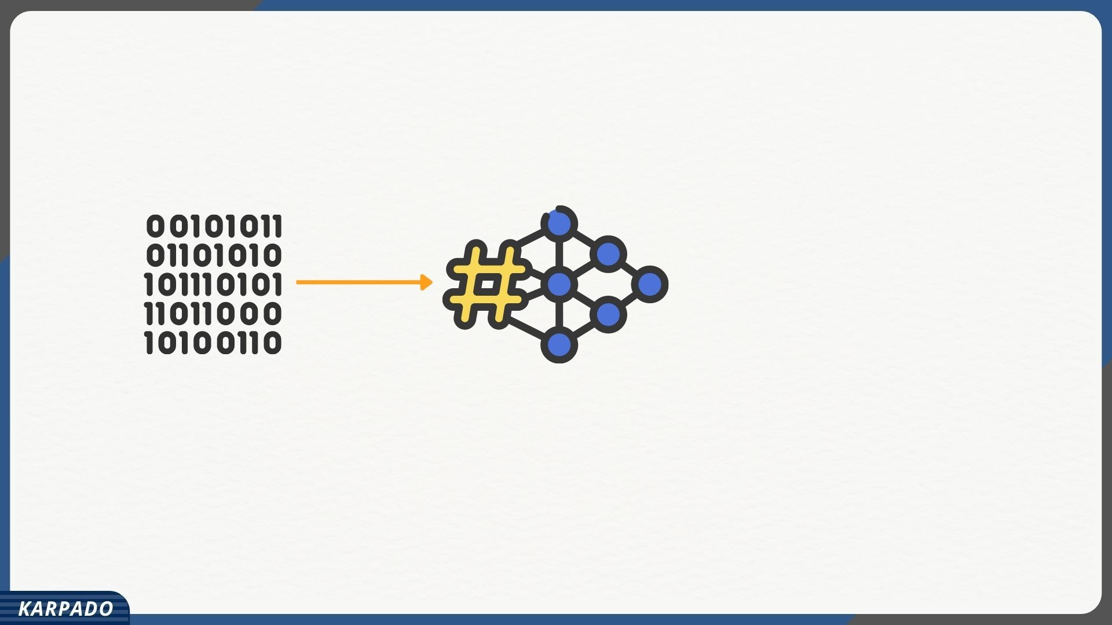

Slide 3
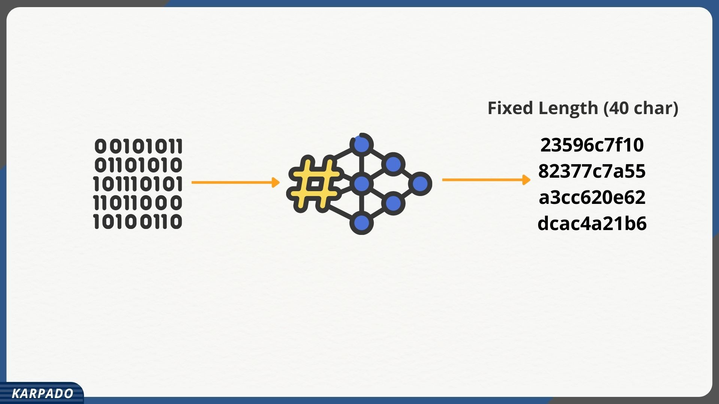

Slide 4
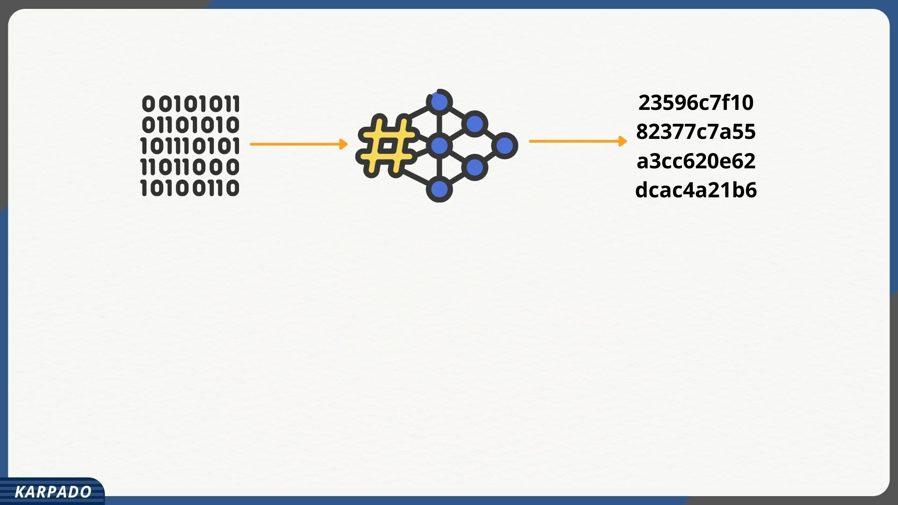
Same input would result in same hash code
Cannot generate data from a given hash code
Difficult to find another input which results in same has code

Slide 5
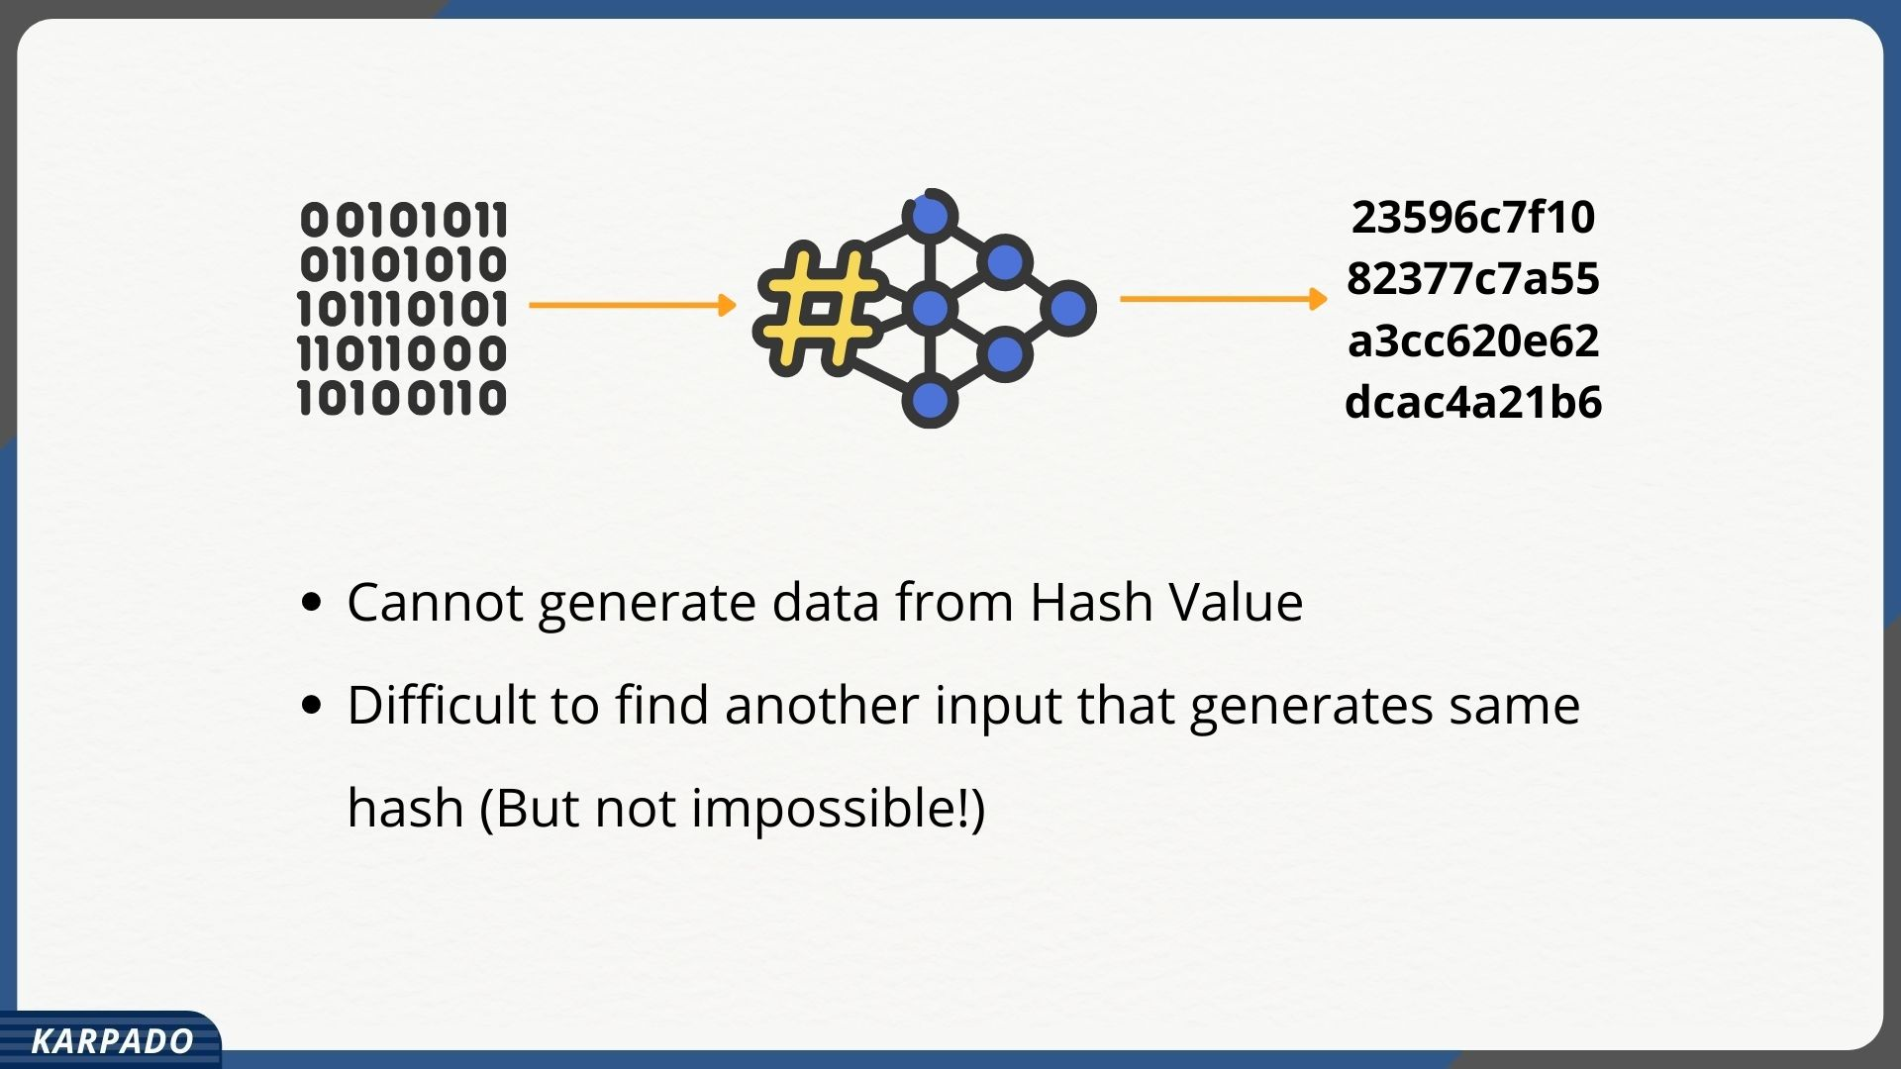

Slide 6
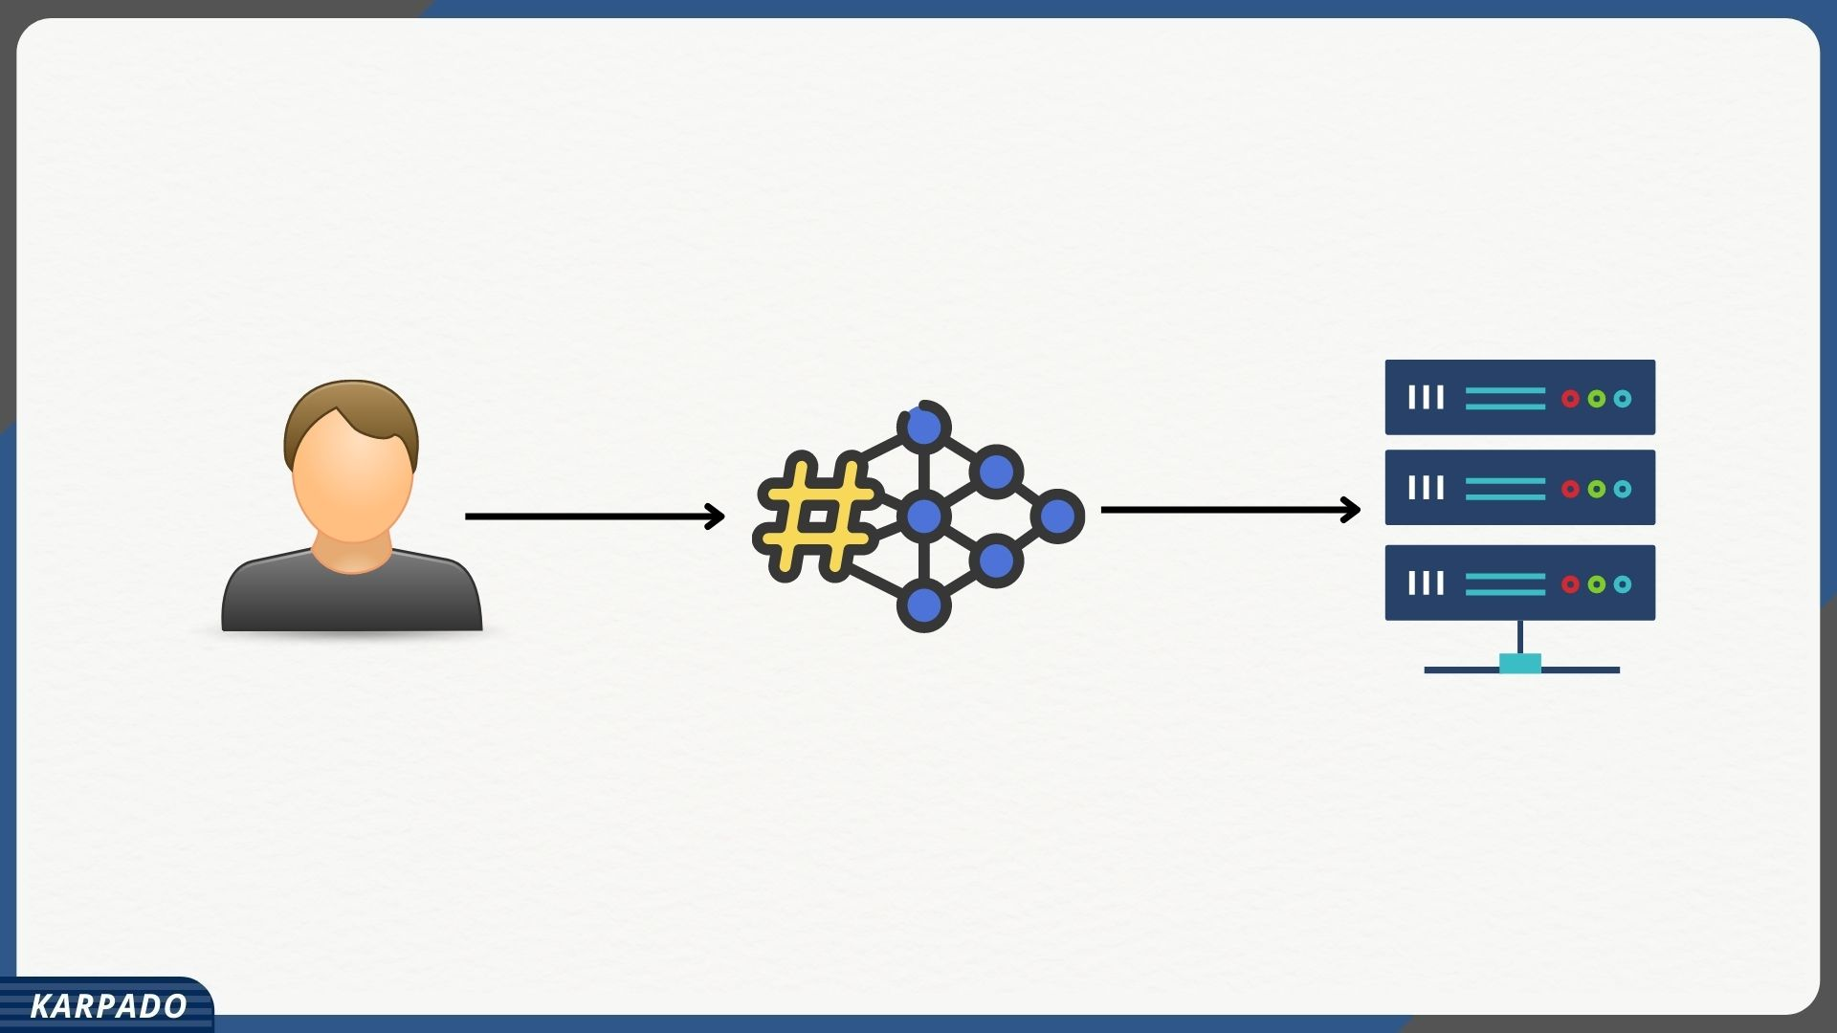

Slide 7
